Slide 1
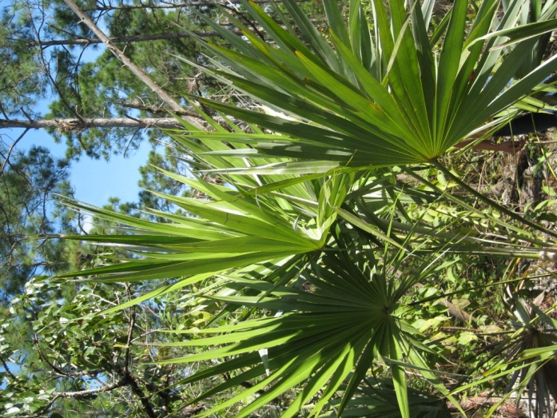
A More Sustainable Home
Tropical Style
Why not breath a little easier
with a little help from our green allies

Slide 2
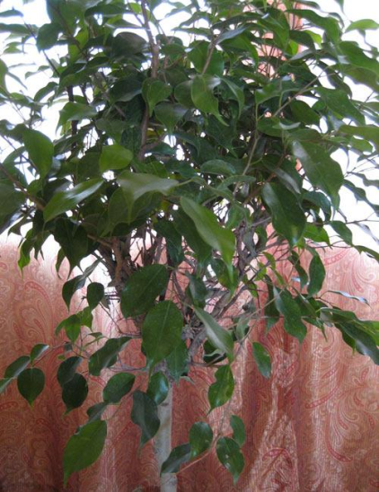
More than just a natural feature in decorating your home
Tropical House Plants help you combat The Deadly 3 VOC’s (volatile organic compounds) in your home:
Benzene
Formaldehyde
Trichloroethylene
Did you know that the photosynthesis of indoor
house plants scrubs these harmful compounds out
of our indoor air. Some pollutants are also absorbed
and rendered harmless in the soil of the potted plant.

Slide 3
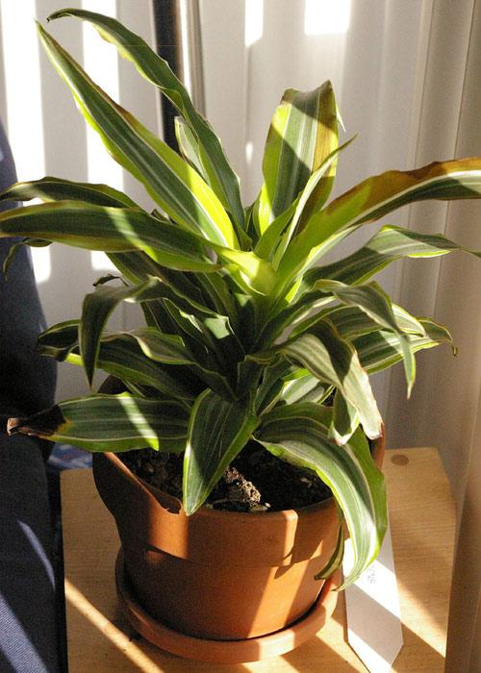
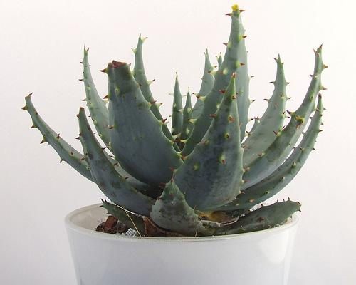
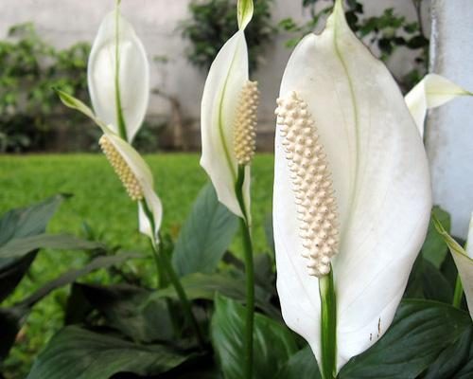
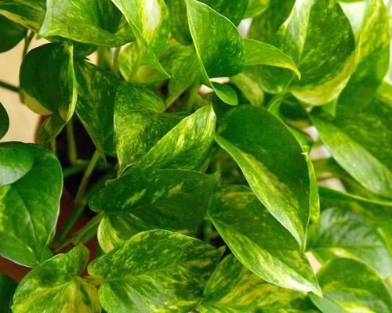
Check out these Common Allies for a healthier & more beautiful home
Do you know which one provides simple, safe and effective first aid?

Slide 4
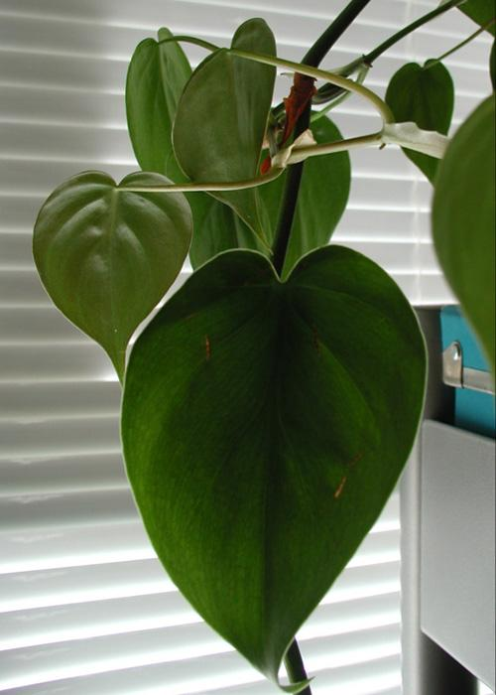
An important Job they do, but pets and small children BEWARE…
While many are beautiful and beneficial, there are some common sense precautions for pets and small children. This lovely philodendron and some of its’ cousins are toxic if injected. Get to know who’s who and place your plants and educate your children for maximum benefits and safety.

Slide 5
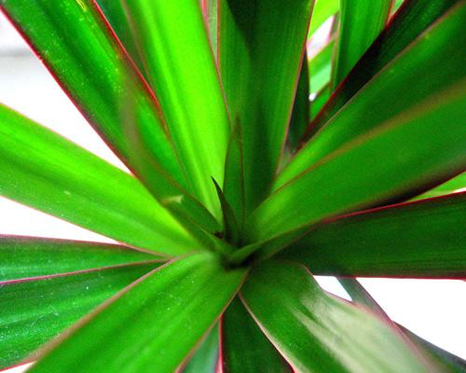
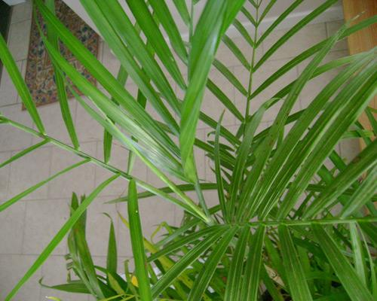
For more info check out www.mnn.com or the NASA 1989 report entitled Interior Landscape Plants for Indoor Air Pollution Abatement.

